Slide 2
ABOUT US
TECHNICAL SPECIFICATION
VALUE PROPOSITION
VISION, MISSION &VALUES
Agenda
INTERNAL ANALYSIS
EXTERNAL ANALYSIS
COMPETITOR ANALYSIS
MARKETING PLAN
STRATEGIC PLAN
FINANCIAL PLAN

Slide 3
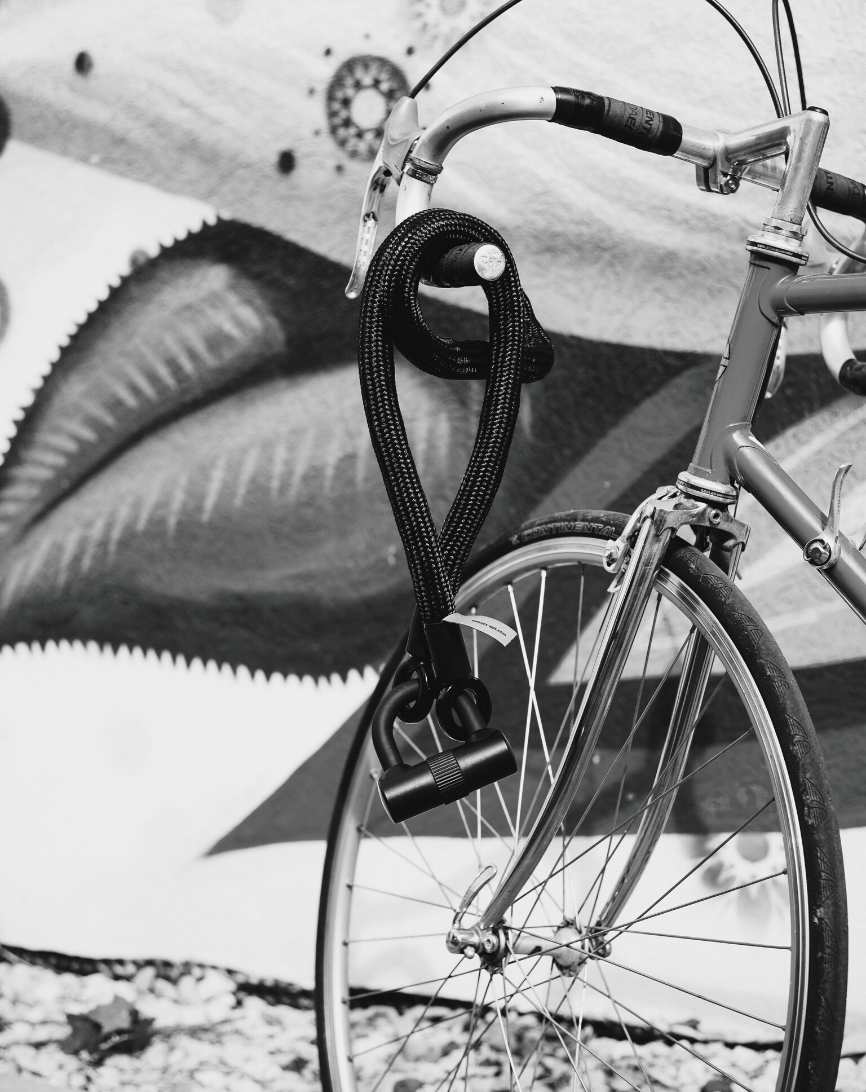
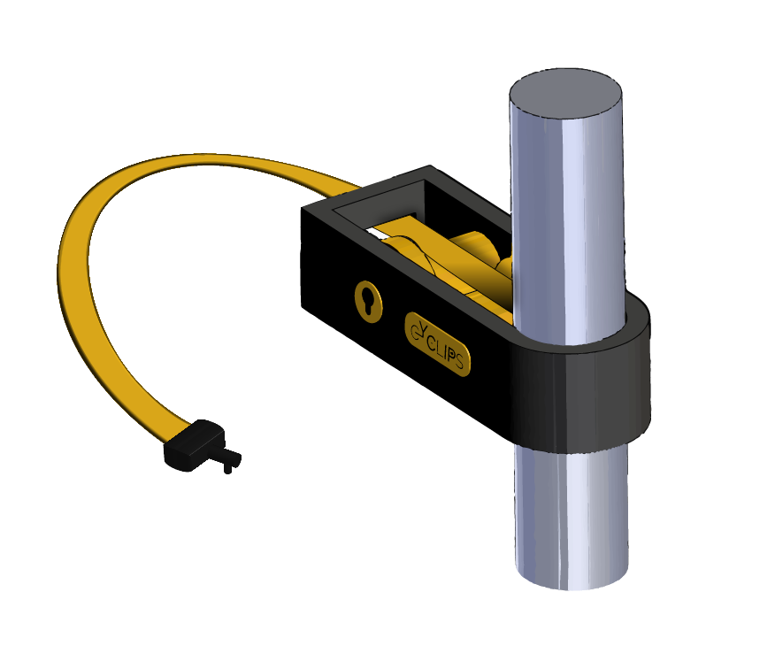
Cyclips has been created to design, promote and sell a new product in the form of a unique kind of bicycle lock.
ABOUT

Slide 4
Our Team
Danisan Emre
Englund Adam
Cadet Rémi
Management Engineering
Management Engineering
Mechanincal Engineering
Yang Isabela
Laonet Paul
Jain Ritesh
Mechanincal Engineering
Aeronautic Engineering
Aeronautic Engineering

Slide 5
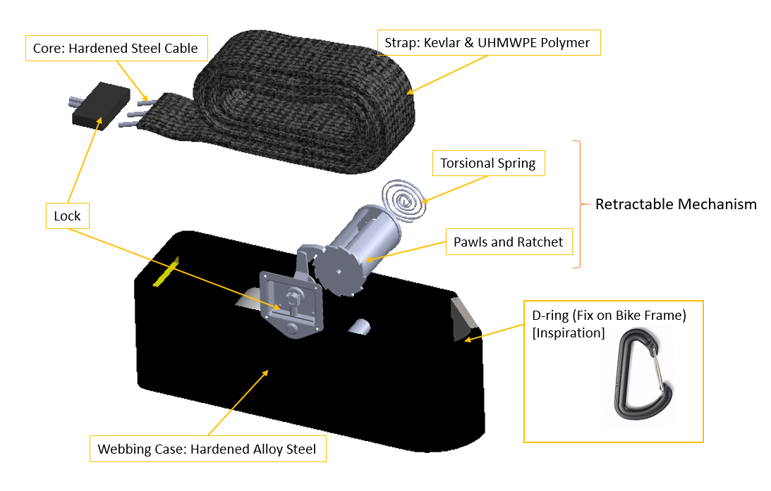
Technical Specification

Slide 6
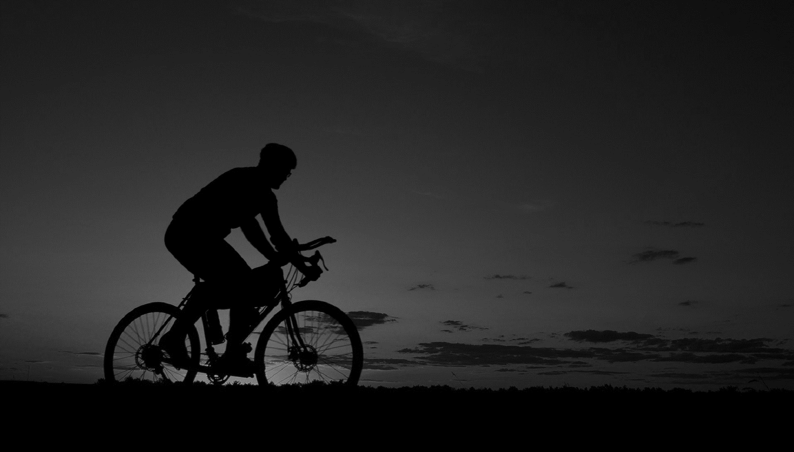
Cyclips aims to provide a bicycle lock for normal and electrical bikes that is theft proof, convenient, clean-cut and not too pricey.
Main Selling Point
Value Proposition
Durability
Retractable Mechanism
Modern Design
Target Customer
Everyday cyclists who care about their bike security and find traditional locks inconvenient

Slide 7
Vision Statement
We want to encourage people to bike and simultaneously make them feel safe and comfortable in their everyday life.
Vision Mission & Values
Mission
Provide customers with a complete experience of safety and convenience.
Values
- Honesty, Trust and Safety
- High Quality
- Community

Slide 8
KEY RESOURCES
The team
The technology
Internal
Analysis
KEY ACTIVITIES (EARLY STAGES)
Development of the Minimal Viable Product
Testing and feedback gathering
Production setup
Execution of marketing & branding strategy

Slide 9
INDUSTRY
External
Analysis
Heavily concentrated
Well established actors
No real market leader
ENVIRONMENT
Increased focus on environmental and health aspects
Governments incentive programs
E-bikes steadily rising

Slide 10
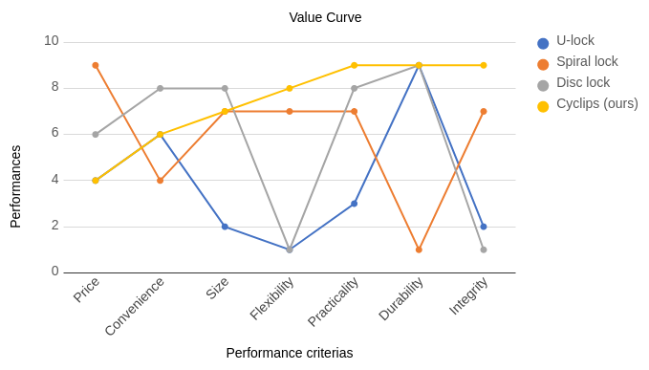
Two price categories:
Cheap (10-20 €)
Medium-High (40-130 €)
Main competitors:
Litelok (Flexible)
Hiplock (Durable)
Vine (Retractable)
Kryptonite (U-lock, Big Cable)
ABUS (U-lock, Big Cable, Foldable)
Foldylock (Foldable)
COMPETITOR ANALYSIS

Slide 11
 | Positive | Negative
Internal | STRENGTHS Practical and Strong; Possibility of add-ons; Not a drastic change of the users' habits, i.e. easy to use; Replaces the use of several bike locks | WEAKNESSES Price; Lack of capital; Lack of reputation; No production facilities; Lack of know-how.
External | OPPORTUNITIES - There is no real market leader or final solution; - There might be a gap in the market for locks which combine high durability and are easy-to-use; - No competition in the 40-80€ price range for retractable bike locks; - Increasing bike usage/active lifestyle; - Increased awareness of sustainability (leading to people using bikes more); - Easy to adopt; - Large possible market; - Possibility of also selling to motorcyclists; - Most cities and governments are actively encouraging biking; - Possibility of state-aided bike incentive programs might get more people to bike (for example, subventions or pay-to-bike-to-work programs which already exist in many Italian cities); - Increased sales of e-bikes which are generally more expensive than regular bikes. | THREATS Many actors are already on the market, many of them established on the bike lock market since a long time and have both money and reputation; Lack of awareness and trust of retractable bike locks; The usage of bike sharing is increasing.
SWOT

Slide 12
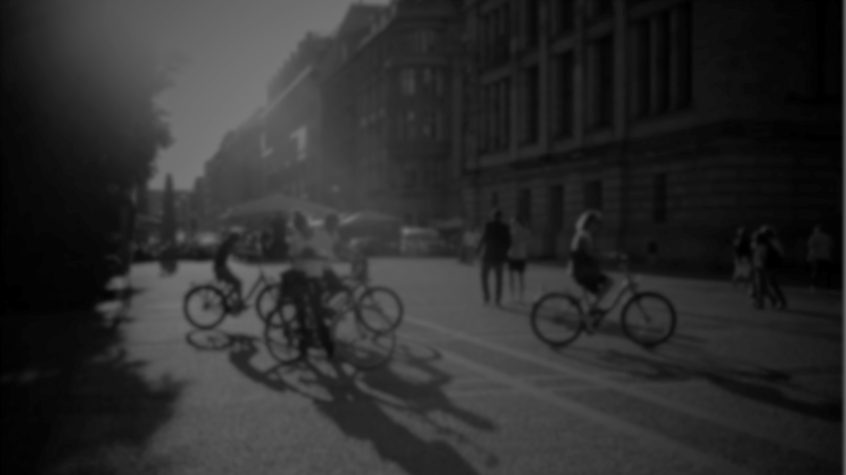
COMPETITIVE ADVANTAGES
Product
Team
- Diverse technical background
- Diverse cultural background
- Start-up experience
- Customer insights
Flexibility of using the product (the retractable aspect)
Durability of the product
Customizability of the product
Ability to change the product and be flexible in production

Slide 13
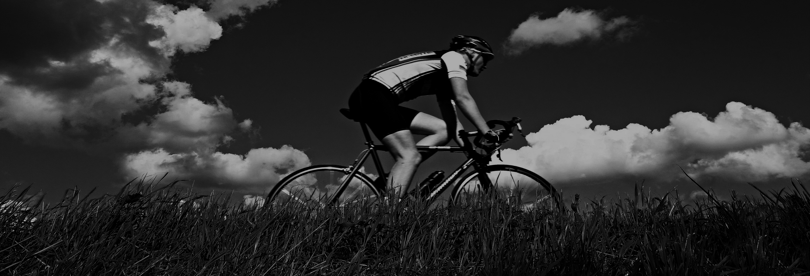
OUR LISTING STRATEGIES
Marketing Plan
Strategic Plan
Financials

Slide 14
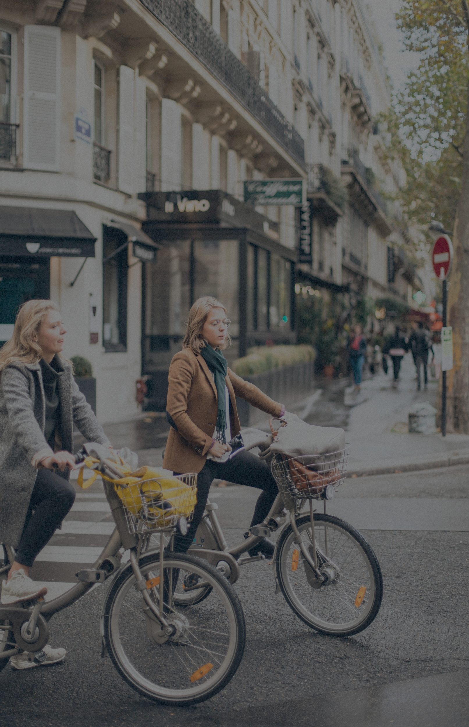
Segmentation
5 Millions Bikes and e-Bikes in Italy 2016
Marketing
Plan
- Urban Riders
- Professional Bikers
- Mountain Bikers
67%
3.4 Millions Middle & High Income Range
Targeting
“Normal and electrical bike owners that are using for daily transportation, who find traditional locks inconvenient to use, and have a middle to high income.”
15%
510 Thousand
Our Reach First Year

Slide 15
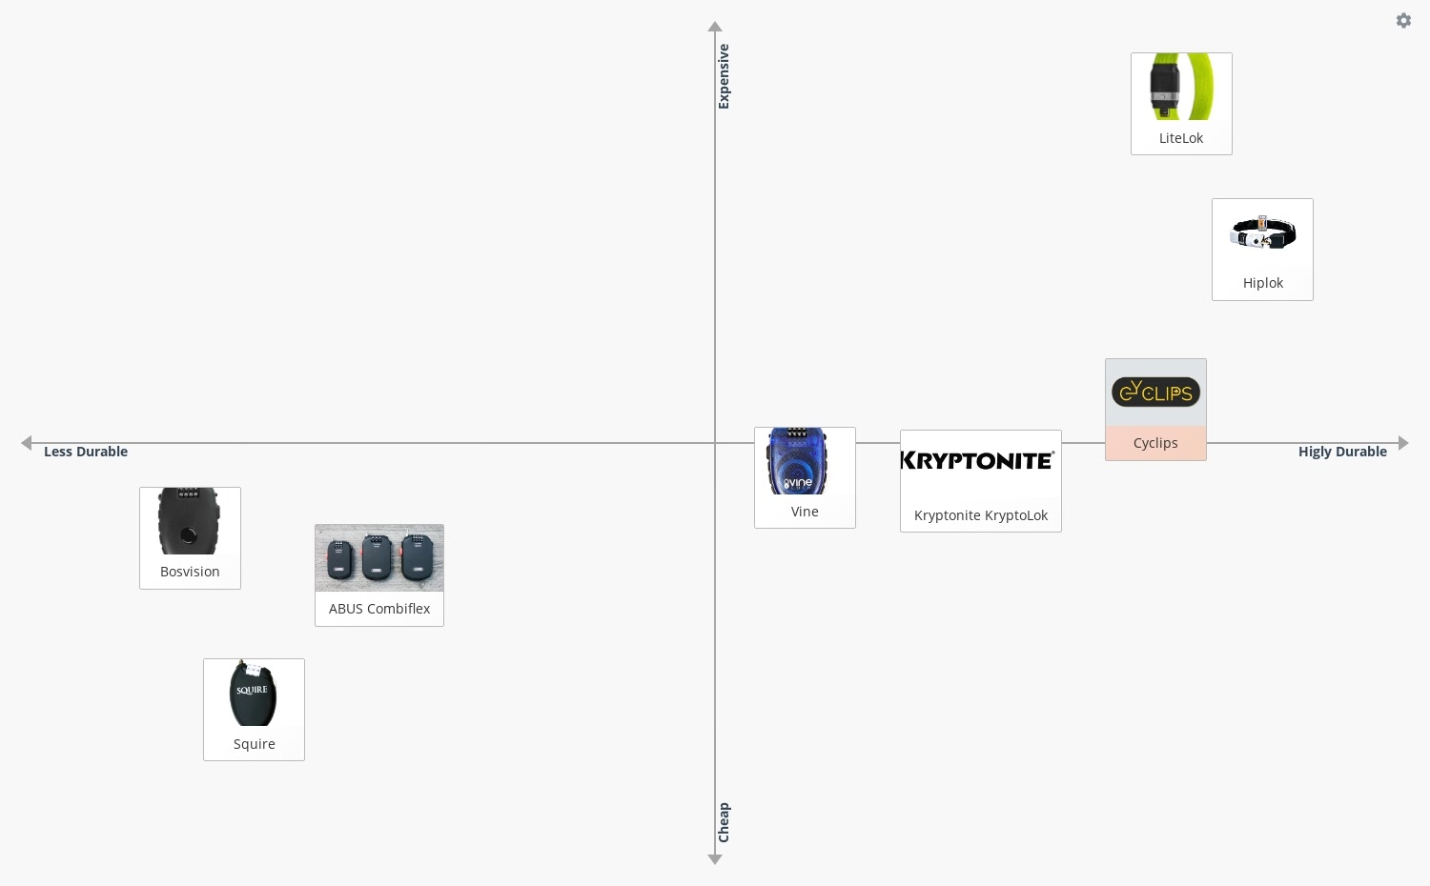
We are positioning our product in the price range of 60-80€, which is the middle-to-high range of the bike locks. Also, high-lighting the strength of the lock will create the perception of a durable and economical luxury product image.
POSITIONING

Slide 16
Product
- Durability (Must-Have)
- Flexibility (Satisfier)
- Customizability (Delighter)
Marketing
Mix
Price
60-80€ segment
Place
- Bike & bike accessory stores​
- Website
Promotion
- Agreements with bike producers & retailers
- Discounts for bike rentals or large numbers
- Cyclist events
- Social influencers

Slide 17
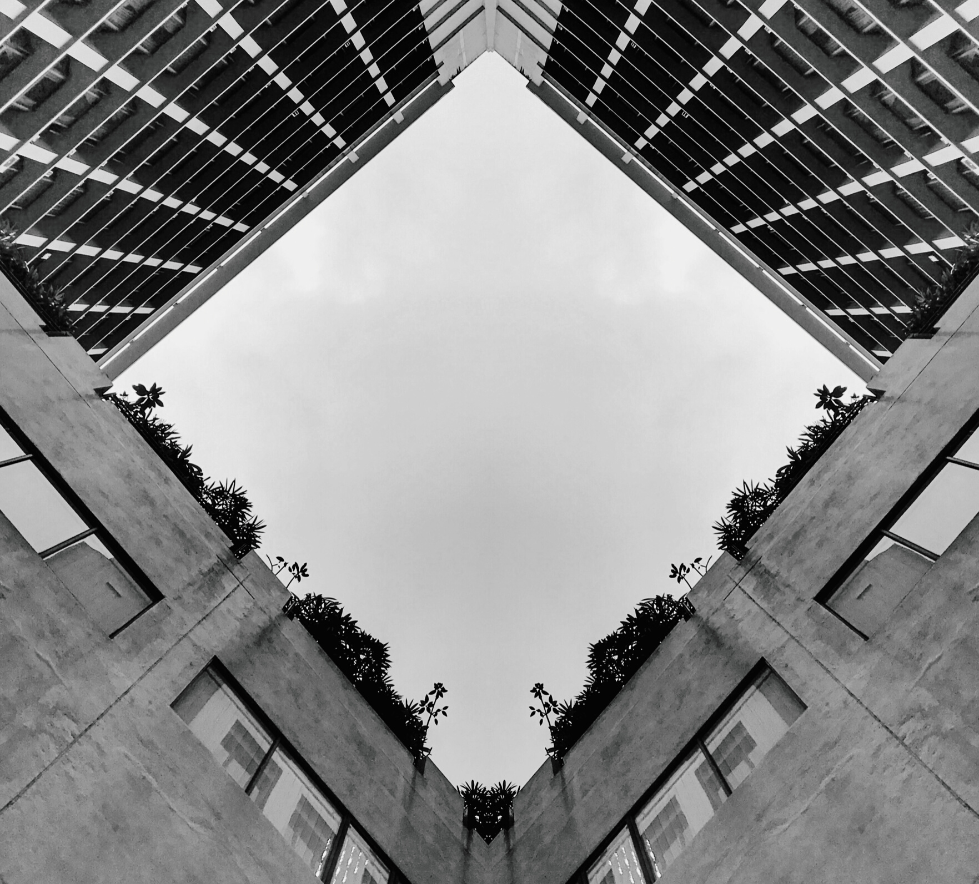
In 3 Months
- Research and prototype development
- Create brand awareness
- Set up sales channels
Strategic Plan
Until 1st Year
- Production of 1200 products
- Sales of at least 60%
- Retailer agreements
- Grow brand awareness
Until 5th Year
- Expanding to 4 countries
- Keep minimum 10% growth/year
- Complementary products

Slide 18
Best, Likely and Worst case scenarios
 | 2020 | 2021
Reach best case | 0.2 | 0.32
Reach likely case | 0.15 | 0.24
Reach worst case | 0.1 | 0.15
Market share best case | 0.02 | 0.04
Market share likely case | 0.01 | 0.02
Market share worst case | 0.005 | 0.015
Sales best case | 3,045 | 12,991
Sales likely case | 761 | 2,679
Sales worst case | 127 | 913
Revenues best case | €243,588 | €1,039,309
Revenues likely case | €60,897 | €214,357
Revenues worst case | €10,149 | €73,076
Net profit best case | €20,129 | €324,015
Net Profit likely case | €-57,131 | €16,542
Net profit worst case | €-75,780 | €-31,731
Financial
Plan
Cyclips Planned Cost & Price
Production Cost / unit | €40
Sales Price | €80
Margin | €40
Total Potential Revenue In Italy
Total Revenue | €4,871,760
Cost of Goods Sold | €2,435,880
Gross Profit | €2,435,880

Slide 19
INVESTMENT & EQUITY
Proposals:
250,000 € for 30% equity
To see the business through the first and second year:
Production of 1200 + 2400 = 3600 units

Slide 20
THANK YOU FOR YOUR TIME!

